Slide 1

API AND REST API

Slide 2
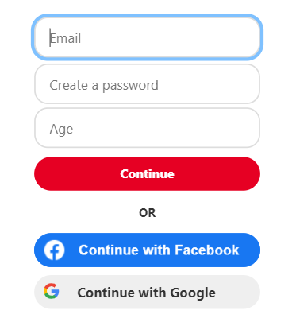
API
Application Programming Interface
Using different services
Allows one software to communicate with another

Slide 3
REST API
REpresentational State Transfer
CLIENT → SERVER
(http)
Uses HTTP Request Methods (get, post)
Pattern for making API’s
Example: Restaurant
We(client) → Kitchen (Server)
Waiter(API)

